Slide 1

Connect- 4 Game
Course:- DIP392
NAME SURNAME, Student I’D: Kushagra Singh, 221ADB063
NAME SURNAME, Student I’D: Pooja Odedara, 221ADB033

Slide 2
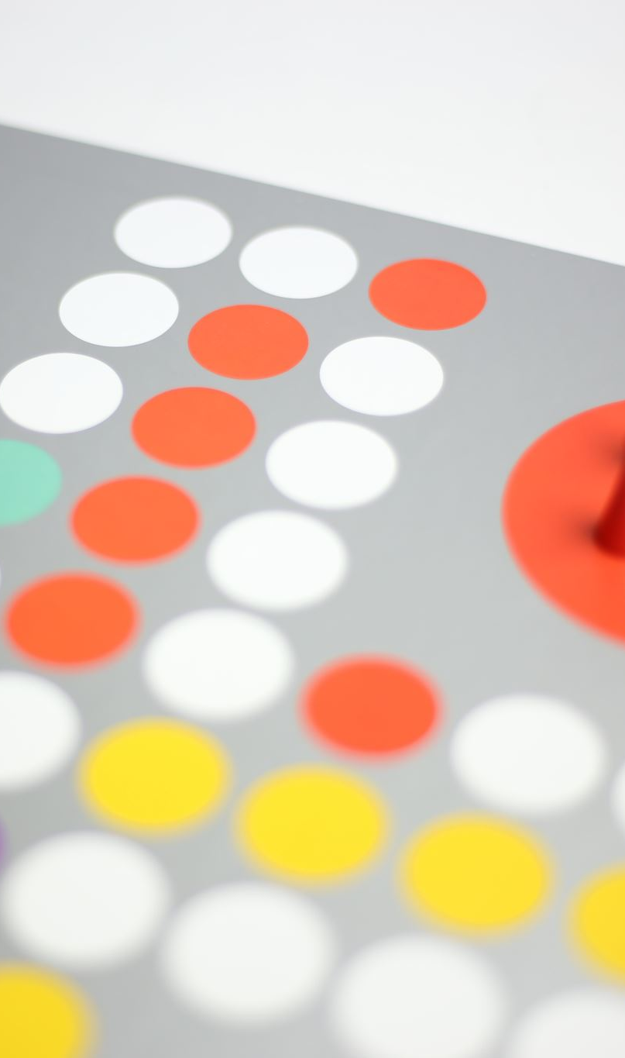
Overview Of The Game Project
The Connect Four game project involves creating a software implementation of the classic two-player connection game. In this game, players take turns dropping colored discs into a vertical grid with the objective of being the first to form a horizontal, vertical, or diagonal line of four of their own discs. The game requires strategic thinking and planning, making it both challenging and entertaining. The project will focus on developing a user-friendly and visually appealing interface, providing an engaging experience for players. The game will also feature a computer AI opponent to allow for single-player gameplay.

Slide 3
Key Features
User Interface: Visually appealing, customizable player colors.
Gameplay Modes: Two Player Mode, Single Player Mode with AI.
Game Mechanics: 7x6 grid, smooth game mechanics.
AI Implementation: Simple AI opponent with randomized moves.
Winning Conditions and Feedback: Win checks, highlighting, real-time feedback.
Customization: Color selection for discs.
Instructions and Usability: Help section, restart options.

Slide 4
Technical Implementation , Requirement Assumptions and Additions
Frontend Development: HTML, CSS, JavaScript
.Responsive Design: Ensuring seamless experience across devices.
Modular Code: Organized JavaScript functions for maintainability.
Assumptions: Basic functionality, user interaction, AI, browser compatibility.
Additions: Game modes, UI enhancements, instructions modal, restart functionality, winning line highlight, dynamic color update, responsive design, CSS animations, error handling, code modularity.

Slide 5
Functional Programming Approach and Benefits
Functional programming (FP) treats computation as the evaluation of mathematical functions.
Key concepts: pure functions, immutability, higher-order functions.
Application in Connect Four:
Pure Functions: checkWin, dropDisc, and updateBoard enhance reliability.
Immutability: Ensures predictable state changes.
Higher-Order Functions: Modular event handling and UI updates.
Conclusion:
FP principles lead to cleaner, maintainable, and reliable code, enhancing the user experience and ease of future updates

Slide 6
Extension and Impact on Design
Extension Overview:
AI Opponent: Upgraded from random moves to a future plan for the Minimax algorithm.
User Interface: Enhanced with CSS Grid, animations, and responsive design.
Customization: Added player disc color selection.
Usability: Instructions modal and restart functionality.
Impact on Design:
AI Logic:
Modular design for easy AI upgrades.
User Experience:
Improved visual feedback and responsiveness.
Customization:
Dynamic color updates enhance user engagement.
Usability:
Clear instructions and easy restart improve accessibility.
Summary:
Extensions led to a more modular, user-friendly, and engaging game, ensuring better performance and future scalability.

Slide 7
Testing Strategies and Lessons Learned
Testing Strategies:
Initialization: Verify empty board, initial player.
Player Moves: Validate moves, and handle full columns.
Game Modes: Test two-player and AI functionality.
Customization: Ensure disc color changes.
Win Conditions: Check all win scenarios and draws.
Usability: Test instructions modal, restart function.
Lessons Learned:
Programming: Improved HTML, CSS, JavaScript, and modular coding.
Process: Importance of requirements, design, incremental development.
Management: Time management, feature prioritization, documentation.

Slide 8
DEMONSTRATION
https://kushagrasingh23.github.io/DIP392-KP/

Slide 9

THANK YOU FOR YOUR ATTENTION !!!
TIME FOR Q&A SESSION

